Slide 1
Wrapper class, string and array
Session 2
D6421 – Muhammad Fikri Hasani

Slide 2
Outline
Course outline
Wrapper Class
String Class
String Method
Array

Slide 3
Wrapper class, string and Array
Wrapper Class
All primitive data types are wrapped into a class in Java and is fixed.
Contains in java.lang package
Used to symbolize the primitive data types in an object if necessary.
Is the final class and interface.
There are 8 primitive data type to be wrapped as Class in Java

Slide 4
Wrapper class, string and Array
Wrapper Class
All numeric class which is derived from abstract class Numeric have method doubleValue(), floatValue(), intValue(), longValue(), shortValue() and byteValue(), which will return the value in to its primitive data type.
Every Wrapped class will override toString() and equals functions which has been define by class Object.
Some numerical and character classes implement the interface Comparable, compareTo function implemented in its class.

Slide 5
Wrapper class, string and Array
Wrapper Class
Each numeric class has constants :
    MAX_VALUE
    MIN_VALUE
MAX_VALUE : maximum value according to its data type
MIN_VALUE : minimum value
    For byte, short, int and long.
    For float and double showing positive values.
Max integer value = 2.147.483.647
Min float value = (1.4E-45)
Max double floating point value = (1.79769313486231570e+308d)

Slide 6


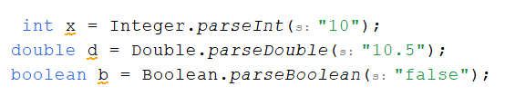
Wrapper class, string and java data structures
Wrapper Class
To initialize value to Wrapper Class, there are 2 ways:
First is using assignment like in primitive data type
Using value of static method. This approach also can help conversing from string.
Each wrapper class also have parseX() (parseInt(), parseDouble(), parseByte()) that can convert string to its corresponding primitive data type.

Slide 7
Wrapper class, string and Array
String Class
A collection of some characters into an array (Array of Character)
String declaration:
String s = "hello world";
Or
String s1 = new String("this is word");
Or using array of char:
char c[] = {'h','e','l'};
String s2 = new String(c);

Slide 8
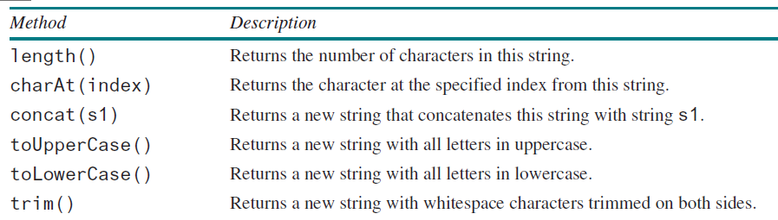
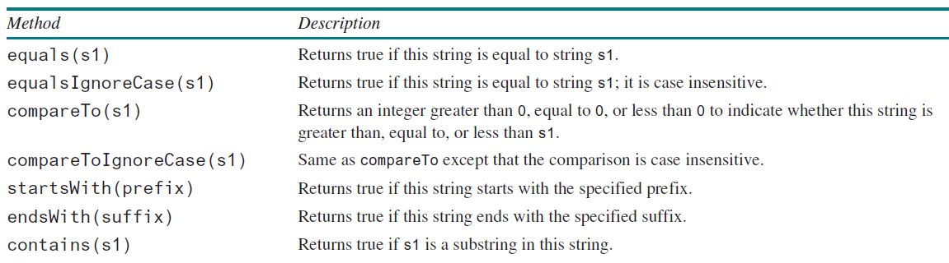
Wrapper class, string and array
String methods
Simple methods for String:
Comparing String:

Slide 9
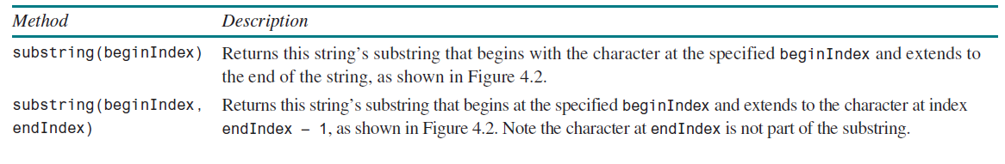
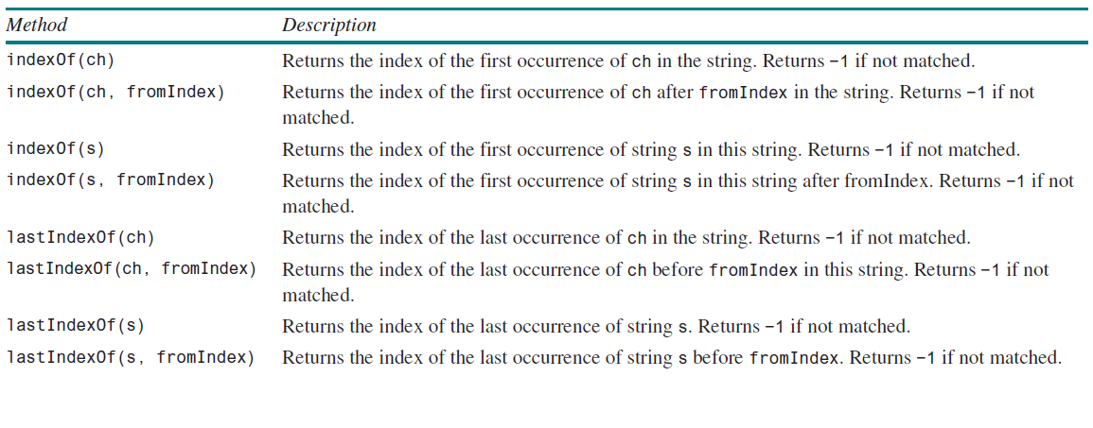
Wrapper class, string and Array
String methods
Substring → string inside of string
Finding a Character or a Substring in a String

Slide 10
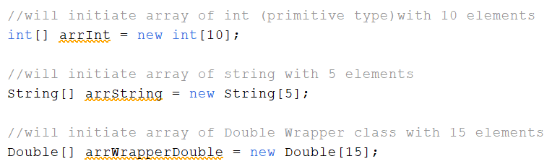
Wrapper class, string and Array
Array
An array is used to store a collection of data, but often we find it more useful to think of an array as a collection of variables of the same type.
The type can be primitive datatype, Wrapper class, or Class
Declaring array:
arrayRefVar[] = new elementType[arraySize];
Example:

Slide 11
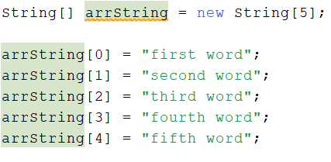
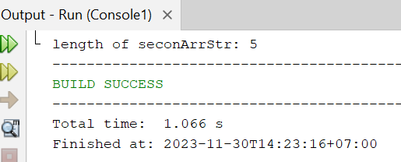

Wrapper class, string and Array
array
Array initialization:
Via assignment for each elements:
Automatic initialization:
Use length property to check array length:

Slide 12

Wrapper class, string and Array
Multidimensional array
Store an array of array.
Usually used to represent table or matrix.
Syntax for 2D array:
arrayRefVar[][] = new elementType[arraySize] [arraySize];
Example:

Slide 13
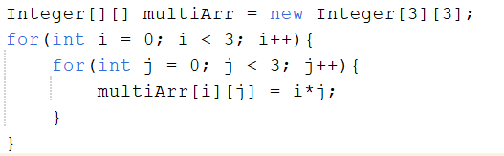
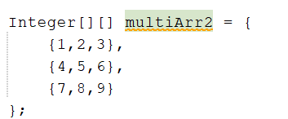

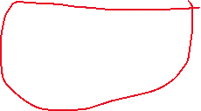
Wrapper class, string and Array
Multidimensional array
To initialize, you can use assignment such as previously (using loop is more preferred to automate multiple index).
Or directly:
Each inner element of higher dimension array is an array
therefore, multidimensional array is array that hold another
array as its element

Slide 14

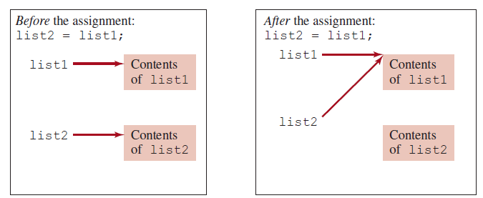
Wrapper class, string and Array
Copying array
There are multiple way to copy array value. Two of the most commons:
First:
However, this statement does not copy the contents of the array referenced by list1 to list2, but instead merely copies the reference value from list1 to list2

Slide 15
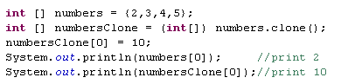
Wrapper class, string and Array
Copying array
To perfectly cloning array, use clone method:

Slide 16


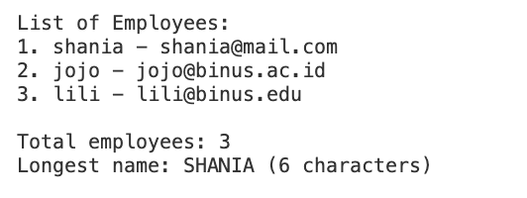
exercise
Employee Management Menu
You are asked to build a simple console-based employee management system.
The program must provide a menu with 3 options:
1. Insert employee data
2. View all employees
3. Exit
Insert Employee Data:
The program must:
Split the input using .split(";") and make sure it has 2 data (name and email only)
Validate that email contains '@'
If valid → save into an array
If not valid → show error
View All Employees:

Slide 17
Wrapper class, string and Array
REferences
Daniel Liang, Introduction to Java Programming and Data Structure, 13th edition.

